Slide 1
MATLAB Programming Midterm One – Part Two
Instructor: 黃世強 (Sai-Keung Wong)
TAs: 劉冠廷, 黃建洲

Slide 2
Midterm instruction
There are two sections. You must finish all of them.
1) Programming section (total 45pt)
You must implement a program to solve each problem
2) Report section (total 5pt = (3+2))
You must write a report to describe how you solve each problem
The approach for solving each problem must be clear and readable.
It contains a structure plan and shows clearly why such approach is adopted.
Each report must contain the number of words between 80 and 120 words in English. The marking scheme of the report is based on the correctness and clarity of the description of the approach. If you use fewer words to describe the approach, your score may be deducted.

Slide 3
Content
There are 2 questions. You must answer all of them.
Each program must be interactive. Deduct 5pt if the program is too slow to run.

Slide 4
About demo video
A demo video may have bugs. The demo video shows roughly the results. These results may not be exactly the same as the requirements. They are for your own reference. You must follow the instruction to finish your programs.

Slide 5
Program file name format
Write all your programs in a folder. The folder name is mat_MT01_P2_ID. For example, if your student ID is 12345678, the folder name is
mat_MT01_P2_12345678 // folder name
Zip the folder and upload it.
Write a program for each problem in one file.
The file name is m01_X_yourStudentID.m, where X is the problem number.
For example, if your student ID is 12345678 and the problem number is 4, then the file name must be m01_4_12345678.m.
You must not output all the intermediate results.
Output the results that are required only.

Slide 6
File content header
At the top of the file, write down your name, ID, email address, department, and date.
%%%%%%%%%%%%%%%%%%%%%%%%%%%
% Midterm Number: …
% Problem number: …
% Student Name: …
% Student ID: …
% Email address: …
% Department:
% Date: ….
%%%%%%%%%%%%%%%%%%%%%%%%%%%%

Slide 7
File content
For each problem, display the problem number before showing the results.
close all; clear; clc; % close all windows
% clear variables, and clear screen
disp('Midterm Problem 1.1') % show Midterm Problem 1.1

Slide 8
About demo video
A demo video may have bugs. The demo video shows roughly the results. These results may not be exactly the same as the requirements. They are for your own reference. You must follow the instruction to finish your programs.

Slide 9
(20 pts) Midterm Problem 1.4. Animation
Plot y(x) = [z1(x) cos (z2(x)) ] / z2(x)
z1(x) = sin (x)*e^{-w sin(x)} + w cos(x)
z2(x) =(x² - 2 x w – 3w²)(|cos(2x)|+u)
The curve of y is divided into three segments due to two singular points.
Ask the user to input u in the interval [0, 1].
If (u == 0) quit the program.
Let w = [0.1:0.05:3]. For each value of w, draw the segments. After a pause for 0.2 second, draw the segments for another c value. Repeat the process. Show the figure on top.
Display each segment in different color. The line width of a curve is 3.
The range of x is [-10, 10]. Make sure that the segments are smooth.
Set the limits of the y axis to -10 and 10.

Slide 10
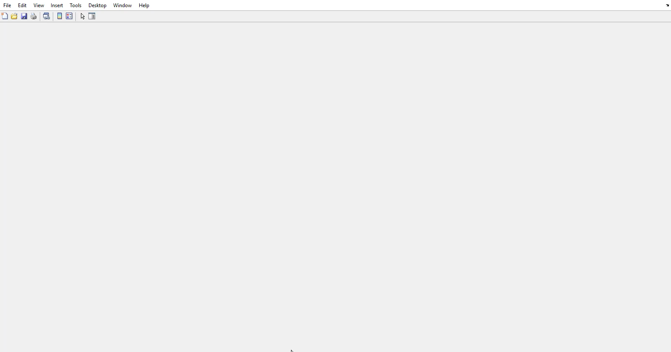
Midterm Problem 1.4. Animation
Play this video to see an animation
u = 0.2

Slide 11
(25 pts) Midterm Problem 1.5
This program manipulates the image, tmp.png. Resize the image to [320 320]. The sweeping line moves 10 units a time. The program should be implemented using a loop-structure. Don’t quit the program until option 0 is selected.
Show the options:
0) Show student name and ID. Then quit the program.
1) Sweeping a line from middle to left
2) Sweeping a line from middle to right
3) Sweeping a line from middle to bottom
4) Sweeping a line from middle to top
5) Turn on or off a spot light at the lower right corner. In other words, raise or reduce the intensities of pixels in a circular disk (i.e., filled circle) at the spot light. The radius of the disk is w/4, where w is the width of the image. Move the spot light from right to left. If the spot light is on, it is off next time.

Slide 12
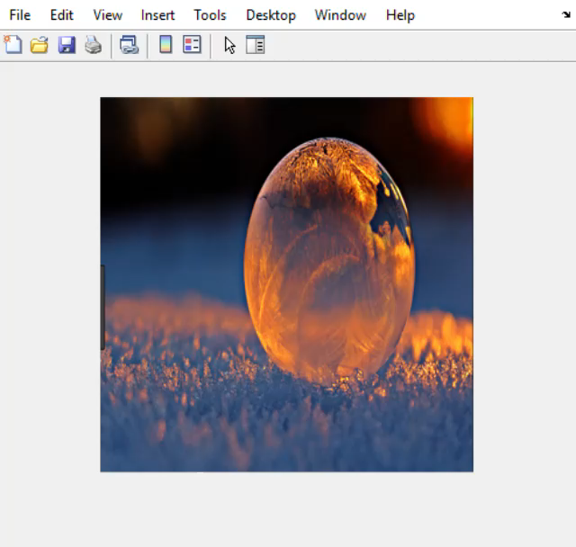
Midterm Problem 1.5
Play this video to see an animation

Slide 13
End
Enjoy MATLAB Programming.

